Slide 1
Interpretable Machine Learning
A shot at opening the Black Box!

Slide 2

What we will Cover?
Why even open the black box?
The approaches
How can we improve further?

Slide 3

Why do we need Interpretation?
Objective of all machine learning algorithms:
Accuracy
$y=f\left(x\right)$
Y – Outcome variable
X – A list of predictors

Slide 4
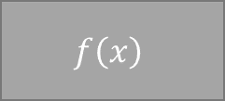

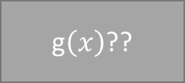

g$\left(x\right)$??
$$y$$
Minimize
X
$$f\left(x\right)$$
$$\hat{y}$$
Model A
Model B
Model C

Slide 5






X
$$f\left(x\right)$$
$$\hat{y}$$
$$x_{1}$$
How each of these impact $\hat{y}$ ?
$$x_{2}$$
$$x_{n}$$
What is the key assumption?

Slide 6
So lets set up our Black Box

Slide 7
So how do we interpret?
Model Specific
GLM
RF
GBM
NN
What’ the problem with these interpretations?

Slide 8
Model Agnostic Interpretations
Global vs Local Interpretations
Global
Permutation based feature importance
Partial dependency
Individual Conditional Expectation (ICE)
Feature Interactions
Surrogate Model
Local
Local Interpretable Model Agnostic Explanations (LIME)
Game Theoretic Approach – Shapley Value
Break Down Approach

Slide 9
Permutation-based feature importance
When a feature value is randomly permuted, there will a decrease in model performance – measure that decrease for every feature
Algorithm:
1. Compute loss function for original model
2. For variable i in {1,...,p} do
| randomize values
| apply given ML model
| estimate loss function
| compute feature importance (ratio measure
between permuted loss & original loss)
3. Sort variables by descending feature importance

Slide 10
Partial Dependence
Understand how the response variable changes as the value of a feature changes while taking into account the average effect of all the other features
Algorithm:
For a selected predictor (x)
1. Construct a grid of j evenly spaced values across the distribution of x: {x1, x2, ..., xj}
2. For i in {1,...,j} do
| Copy the training data and replace the original values of x with the constant xi
| Apply given ML model (i.e., obtain vector of predictions)
| Average predictions together
3. Plot the averaged predictions against x1, x2, ..., xj

Slide 11
Individual conditional expectation (ICE)
Similar to PDP, but instead of checking overall impact of one variable, we check the impact of different levels for that one variable
Algorithm
For a selected predictor (x)
1. Construct a grid of j evenly spaced values across the distribution of x: {x1, x2, ..., xj}
2. For i in {1,...,j} do
| Copy the training data and replace the original values of x
with the constant xi
| Apply given ML model (i.e., obtain vector of predictions)
3. Plot the predictions against x1, x2, ..., xj with lines connecting oberservations that correspond to the same row number in the original training data

Slide 12
Feature Interactions
A single feature may not be very important, but in interaction with another feature, can contribute a lot to the prediction
There are two sets of interactions:
The interaction between two features, which tells us how strongly two specific features interact with each other in the model;
The interaction between a feature and all other features, which tells us how strongly (in total) the specific feature interacts in the model with all the other features.

Slide 13
Algorithm For Overall Interaction
1. For variable i in {1,...,p} do
| f(x) = estimate predicted values with original model
| pd(x) = partial dependence of variable i
| pd(!x) = partial dependence of all features excluding i
| upper = sum(f(x) - pd(x) - pd(!x))
| lower = variance(f(x))
| rho = upper / lower
2. Sort variables by descending rho (interaction strength)

Slide 14
Algorithm For Individual Interaction
1. i = a selected variable of interest
2. For remaining variables j in {1,...,p} do
| pd(ij) = interaction partial dependence of variables i and j
| pd(i) = partial dependence of variable i
| pd(j) = partial dependence of variable j
| upper = sum(pd(ij) - pd(i) - pd(j))
| lower = variance(pd(ij))
| rho = upper / lower
3. Sort interaction relationship by descending rho (interaction strength)

Slide 15
Surrogate Model – Surrogate Trees
This one simpler than the other ones
Basically it uses the ensemble to make predictions
Then back calculates a decision tree with fewer major variables – we need to specify the number of variables we want to check

Slide 16
Local interpretable model-agnostic explanations (LIME)
An algorithm that helps explain individual predictions
Bases on the assumption that every complex model is linear on a local scale (i.e. in a small neighborhood around an observation of interest) and asserting that it is possible to fit a simple surrogate model
Algorithm:
Permute your training data to create replicated feature data with slight value modifications.
Compute proximity measure between the observation of interest and each of the permuted observations.
Apply selected machine learning model to predict outcomes of permuted data.
Select m number of features to best describe predicted outcomes.
Fit a simple model to the permuted data, explaining the complex model outcome with m features from the permuted data weighted by its similarity to the original observation.
Use the resulting feature weights to explain local behavior.

Slide 17
Shapley – Game Theoretic Approach
Shapley game concept: https://www.youtube.com/watch?v=w9O0fkfMkx0
Algorithm:
Similar to lime – we pick an observation and collect samples from the training data
we focus on the impact of feature X1
create two copies of an individually sampled row and randomize the order of the features.
Then in one copy we include all values from the observation of interest for the values from the first column feature up to and including X1
In the second copy, we include all values from the observation of interest for the values from the first column feature up to but not including X1.
Then we apply our model to both copies of this row and compute the difference between the predicted outputs.
Repeat for all sampled rows

Slide 18
Localized step-wise procedure
Take the value for a given feature in the single observation of interest, replace all the observations in the training data set, and identifies how it effects the prediction error.
Perform this process iteratively and independently for each feature, identify the column with the largest difference score, and adds that variable to the list as the most important.
This feature’s signal is then removed (via randomization), and the procedure sweeps through the remaining predictors and applies the same process until all variables have been assessed.

Slide 19
So where now?
This is an emerging area – loads more to work on
A potential new approach can be to check model accuracy and these interpretabilities by using chain of Monte Carlo Shocks in the Data
This will help in making more robust predictions
Re-imagining a model as a network – each feature is a node and they interact differently and in different strengths with the other variables

Slide 20
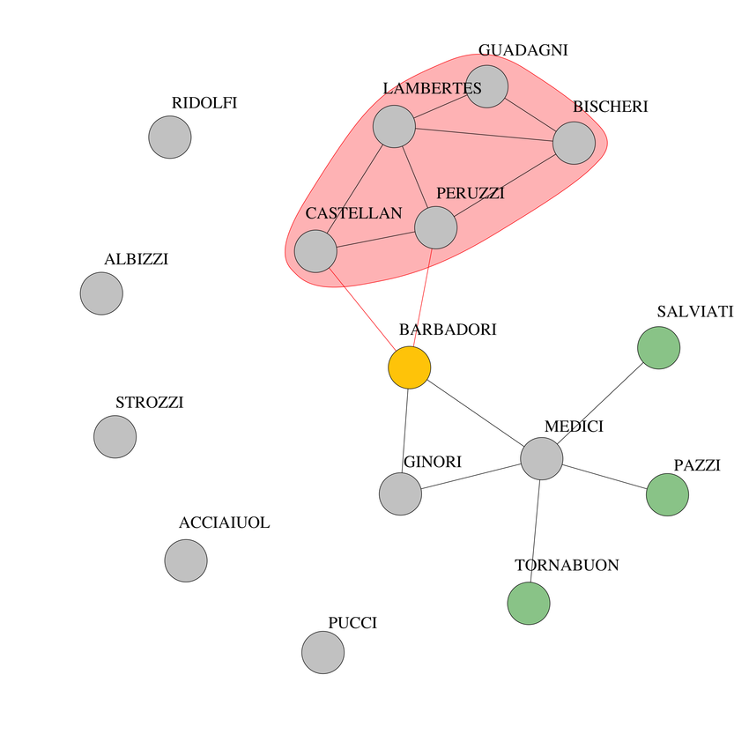
A bit more on the network interpretability model

Slide 21
References and Further Reads
PDP - Friedman, Jerome H. 2001. “Greedy Function Approximation: A Gradient Boosting Machine.” Annals of Statistics. JSTOR, 1189–1232.
Feature Interaction - Friedman, Jerome H, Bogdan E Popescu, and others. 2008. “Predictive Learning via Rule Ensembles.” The Annals of Applied Statistics 2 (3). Institute of Mathematical Statistics: 916–54.
Lime - Ribeiro, Marco Tulio, Sameer Singh, and Carlos Guestrin. 2016. “Why Should I Trust You?: Explaining the Predictions of Any Classifier.” In Proceedings of the 22nd Acm Sigkdd International Conference on Knowledge Discovery and Data Mining, 1135–44. ACM.
Shapley - https://github.com/bgreenwell/fastshap#Background
Štrumbelj, Erik, and Igor Kononenko. 2014. “Explaining Prediction Models and Individual Predictions with Feature Contributions.” Knowledge and Information Systems 41 (3): 647–65. https://doi.org/10.1007/s10115-013-0679-x.
Dalex: Staniak, Mateusz, and Przemyslaw Biecek. 2018. “Explanations of Model Predictions with Live and breakDown Packages.” arXiv Preprint arXiv:1804.01955.
Book on IML:https://christophm.github.io/interpretable-ml-book/ [Free]

Slide 22
Thank You

